Slide 1
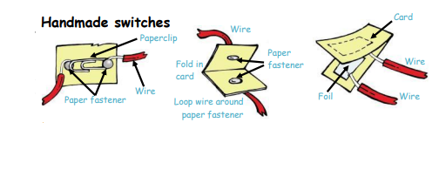
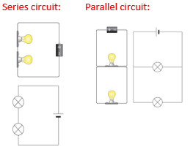
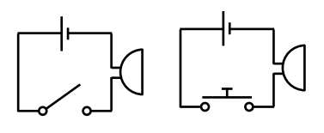
Electricity –By the end of this topic you will be able to build circuits for different purposes and discuss what happens when a component in a circuit is changed
Key Vocabulary
Circuit | A complete and closed path around which a circulating electric current can flow
Series | The definition of a series circuit is an electric circuit in which the electric passes through each circuit element in order. An example of a series circuit is a type of electrical system in a house.
Parallel voltage | The voltage across components in a parallel circuit is the same for each component.
Volts | The volt is a unit by which we measure something.. The force of an electrical current.
Amps | Electrical current is measured in Amps or Amperes.
Current | Flow of electrical charge
3. To compare and give reasons for variations in how components function
We will have a go at making our own switches, which we will use to control a circuit. We will us this investigation to help us decide which switch would be best for a burglar alarm.
4. To use recognised symbols when representing a simple circuit diagram
To know how to increase the volume of a buzzer
We will investigate ways to create the
Lo loudest buzzer.
5. To design a burglar alarm
2. To compare and give reasons for variations in how components function
We will learn about the appearance and function of different electrical components, including switches, bulbs, buzzers, motors, cells and wires. They match pictures of each component to their electrical symbols.
6. To make a burglar alarm
Push-to-break switch – a switch turned off by pressing it.
Push-to-make switch – a switch turned on by pressing it.
Reed switch – a switch operated by a magnet.
Toggle switch – a switch operated when a lever is pressed

