Slide 1
Advent

Slide 2
Advent
What is Advent ?
Advent marks the season before Christmas.
It starts at the beginning of December for the four Sundays before the birth of Jesus.
In the hectic space where people are busy getting ready, it offers us the space to get ready in our heads and hearts.

Slide 3
Advent is..
Hope
Anticipation
Excitement
Attentiveness
Preparation
Time of waiting
Patience
Peace
Joy
Possibilities Trust
Notes:
Which word do you feel best describes your Advent? Advents past? Which word would you like to focus on in this Advent?

Slide 4
Advent at St Mary’s
We are very busy at school, keeping up all of our learning and adding in rehearsals for the nativity and practising hymns for the Advent and Christmas services.
Many of us have been visiting local community groups to share songs, poetry and readings.
We have shared the following video in school to help us think about ways that we can celebrate how we share and how we might be more caring in this season. Click to start..

Slide 6
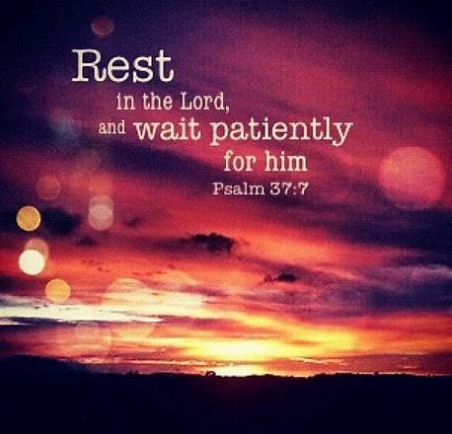
Themes of Advent
Peace
Possibilities
Trust
Patience

Slide 7
Peace brings possibilities

Slide 8
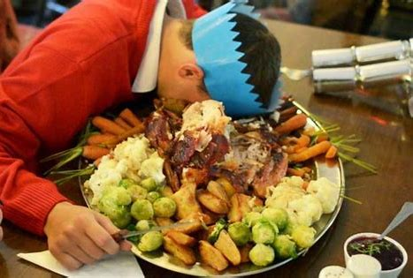
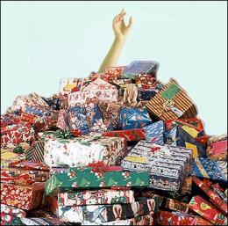
External world A world of doing and having
Notes:
What are the positives and negatives?

Slide 9
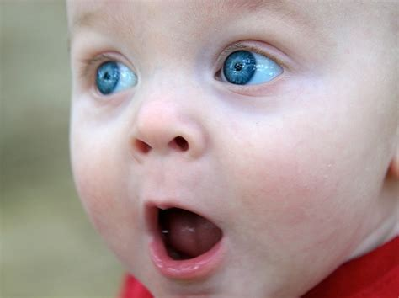
Inner world Finding peace, joy and hope
Joy
Hope
Peace and Love
Notes:
Share some moments when you were filled with wonder and awe.

Slide 10
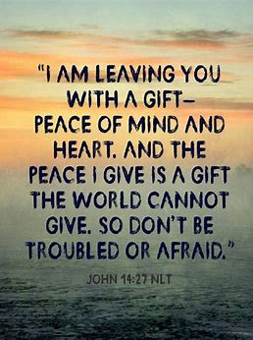
When we are at peace we are able to be bold;
to imagine new possibilities .

Slide 11
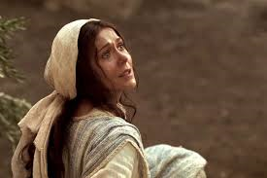
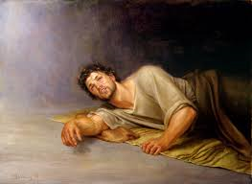
Advent is a time to be open to new possibilities
Mary was able to say yes
Joseph was able to say yes
We can learn and be inspired by their courage
Notes:
Has there been a time when you just had to be guided by blind faith?

Slide 12
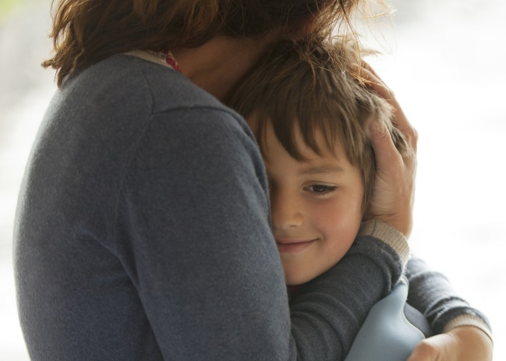
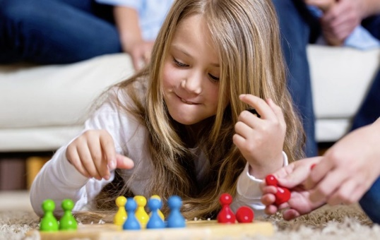
Possible possibilities

Slide 13
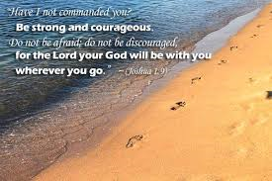
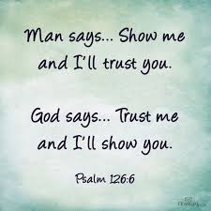
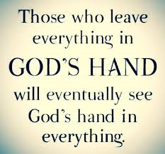
Trust
Trusting others and building the strength of friendship and community brings us confidence. It can lighten and lift our worries.

Slide 14
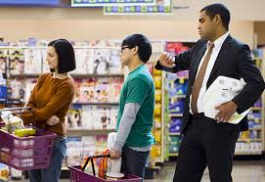
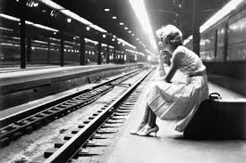
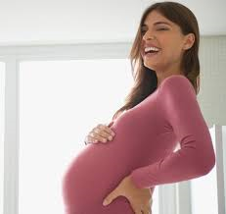
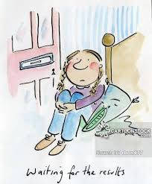
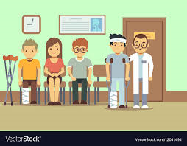
Patience

Slide 15
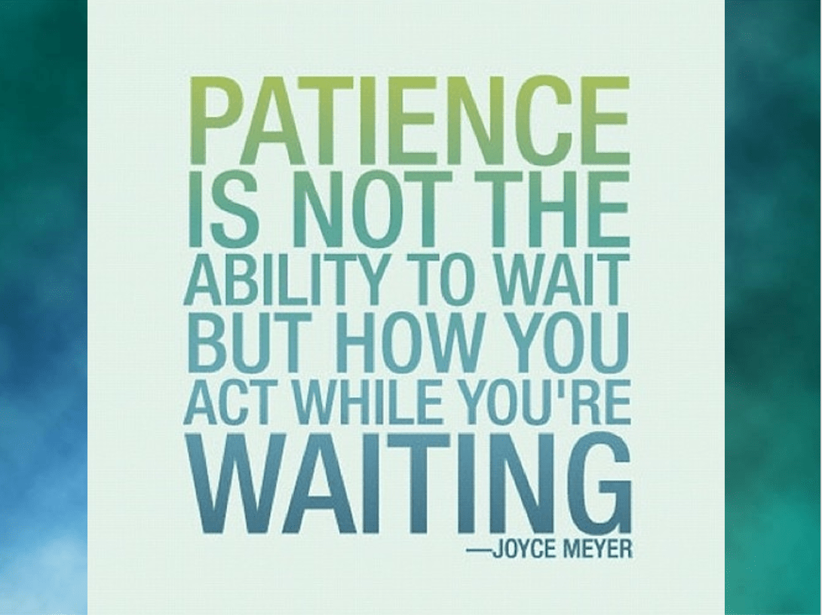
Why is waiting good for us?
If you could have it all now it would mean nothing to you tomorrow.

Slide 16
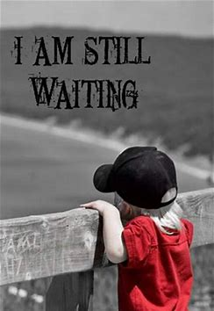
Waiting Builds Patience In Our Lives
Patience in waiting for small things leads to having patience in the bigger things.
We tend to think that the bigger things in life are the most important; what we own, what we have.
When we are asked to stop we often realise that it is the relationships we have and the changes we make in each other that matter the most.
Waiting Builds Anticipation
Why do children get so excited around Christmas? Because the wait has produced anticipation. We tend to appreciate things the longer we have to wait for them.
When we have to wait for something , we tend to value and take care of it more than if it comes easily. .
Notes:
Are we too governed by short-term gains?

Slide 17
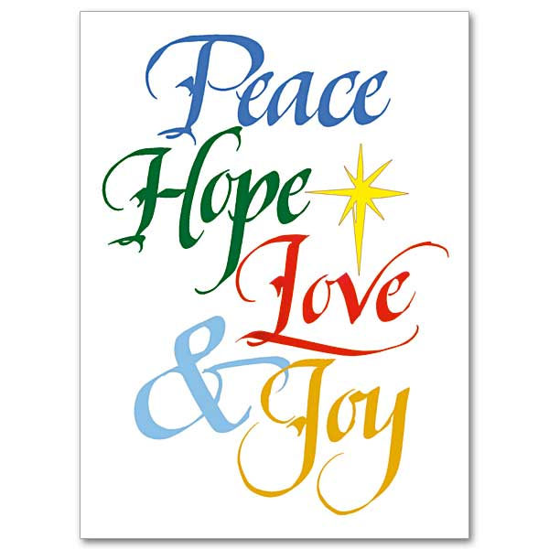
Happy Advent
We look forward to sharing our Advent and Christmas services with you over the next two weeks.
Please do come and share with us if you can.

