Slide 1
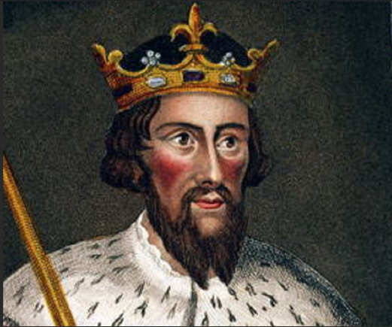
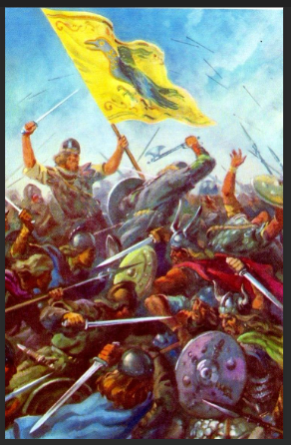
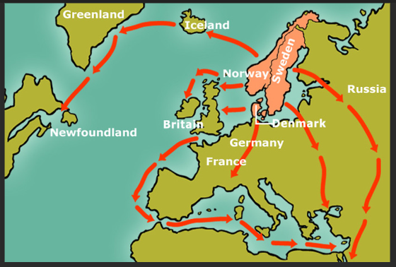
VIKINGS
Key Vocabulary
Viking | Viking is the modern name given to seafaring people originally from Scandinavia
Longboat | A longboat is a type of ship’s boat that was in use from circa 1500 or before.
Battle of Edington | At the Battle of Edington, an army of the kingdom of Wessex under Alfred the Great defeated the Great Heathen Army led by the Dane Guthrum.
Scandinavia | Scandinavia is a sub-region in Northern Europe.
Pagans | A person holding religious beliefs other than those of the main world religions.
Kingdom | A territory, state, people or community ruled over by a king or queen.
Danegeld | Danegeld was a tax raised to pay tribute or protection money to the Viking raiders to save a land from being ravaged.
Invasion | An invasion is a military offensive in which large numbers of combatants of one territory aggressively enter territory owned by another.
Resistance | The act or power of opposing or withstanding.
Primary source | First-hand accounts of events, and include sources like diaries, photographs, songs and newspaper articles.
Secondary source | Second-hand accounts that usually analyse and draw conclusions on events. This includes sources like textbooks, essays and commentaries.
3. Who was Alfred the Great?
Viking raids and invasions were resisted by Alfred the Great. By AD 874, almost all the
Kingdoms had fallen to the Vikings all except for Wessex, which was ruled by Alfred
the Great.
4. To recognise primary and secondary sources
Primary sources are first-hand accounts of events, and include sources like diaries, photographs, songs and newspaper articles.
Secondary sources are second-hand accounts that usually analyse and draw conclusions on events. This includes sources like textbooks, essays and commentaries.
1. Who were the Vikings?
Vikings left their homelands in Scandinavia and travelled by Longboat to countries like Britain and Ireland.
5. Battle of Edington
2. Compare how Vikings settled both peacefully and through fighting
Vikings fought the local people, stealing from churches and burning buildings to the ground.
Others came peacefully to settle. They were farmers, and kept animals and made beautiful metalwork and wooden carvings.
6. Assessment
What have we learnt about the Vikings?
How will you demonstrate your knowledge of the Vikings?

