Slide 1
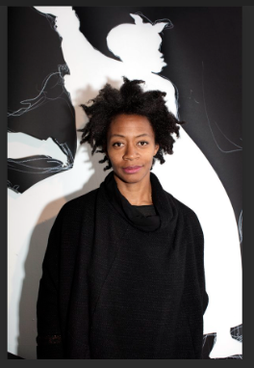
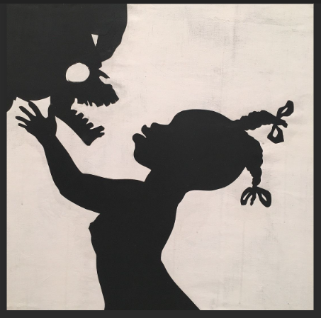
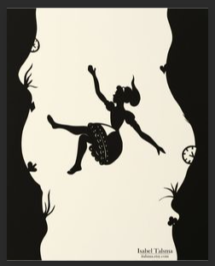
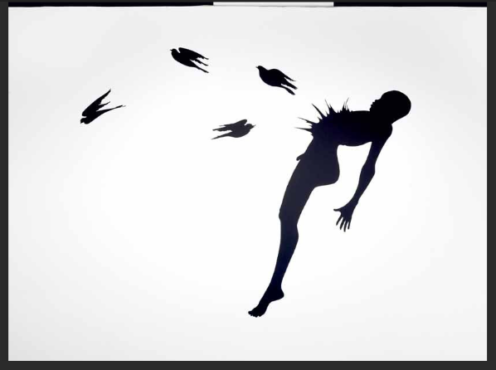
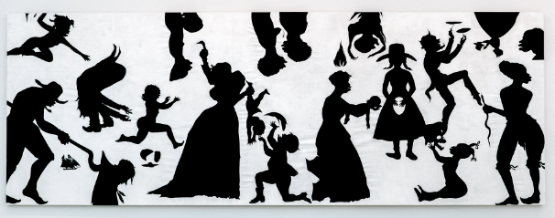
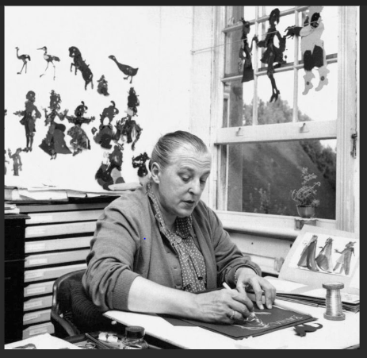
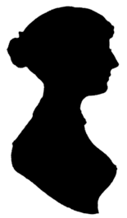
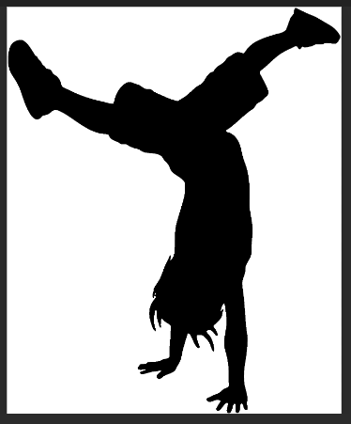
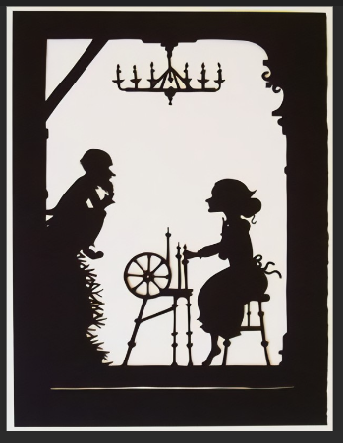
Kara Walker
Key Vocabulary
Silhouette | A shadow profile cut from black paper.
Shadow | A dark area or shape produced by a body coming between rays of light and a surface.
Technique | A way of carrying out a particular task, especially the execution or performance of an artistic work or a scientific procedure.
Traditional | Existing in or as part of a tradition; long-established.
2. To explore the work of Kara Walker
Kara Elizabeth Walker is an American contemporary painter, silhouettist,
print-maker, installation artist, filmmaker, and professor who explores race,
gender, sexuality, violence, and identity in her work. She is best known for
her room-size tableaux of black cut-paper silhouettes.
2. To explore the work of Lotta Reiniger
Lotte Reiniger was a German film director and the foremost pioneer of silhouette animation. Reiniger’s art style was developed from her love of paper animation and the theatre.
Reiniger had a distinct art style in her animations that was very different
from other artists in the time period of the 1920s and the 1930s. In the
1920s especially, characters tended to rely on facial expressions to express
emotions or action, while Reiniger's characters relied on gestures to display
emotions or actions. Reiniger’s cutout animations had a fluid quality that
expressed character’s emotions and actions in a way that was not possible
through traditional silent film.
1. To experiment with silhouettes
We will need black paper, scissors, glue and our imaginations in order to make silhouettes. The word ‘silhouette’ comes from an art form where a shadow profile was cut from black paper. It provided a simple and inexpensive alternative for those who could not afford more decorative and expensive forms of portraiture, such as painting or sculpture.
3. To create own cut-out story

Slide 2
